Slide 1
Development and Prototyping
SE495: Software Entrepreneurship

Slide 2
Outline
Overview
Agile and Lean Principles
Prototyping and Testing
DevOps
Cloud-based Development and Containerization
MVP and Customer Feedback

Slide 3
Overview

Slide 4
Why Development and Prototyping Matter
Development and prototyping are critical steps in turning ideas into functional software products.
They allow entrepreneurs to test and validate their ideas, identify potential issues, and refine their products.
Development and prototyping also help entrepreneurs to communicate their ideas effectively to stakeholders, investors, and potential customers.

Slide 5
What is Development?
The process of designing, creating, testing, and maintaining software products.
Key stages of software development
Requirements gathering, design, implementation, testing, deployment, and maintenance.
Importance of development in software entrepreneurship
Turning ideas into functional products that meet customer needs.

Slide 6
What is Prototyping?
The process of creating a preliminary or experimental model of a product, service, or system.
Key purposes of prototyping
Testing, validating, and refining ideas, identifying potential issues, and communicating concepts to stakeholders.
Importance of prototyping in software entrepreneurship
Allows entrepreneurs to validate their ideas before investing time, money, and resources into a full-scale product development.

Slide 7
Best Practices for Development and Prototyping
Best practices for development:
Define clear requirements and goals.
Follow a structured development process.
Test and validate the product regularly.
Document the development process and product features.

Slide 8
Best Practices for Development and Prototyping
Best practices for prototyping:
Start with a simple, low-fidelity prototype.
Test the prototype with real users.
Refine the prototype based on user feedback.
Use prototyping as an iterative process.

Slide 9
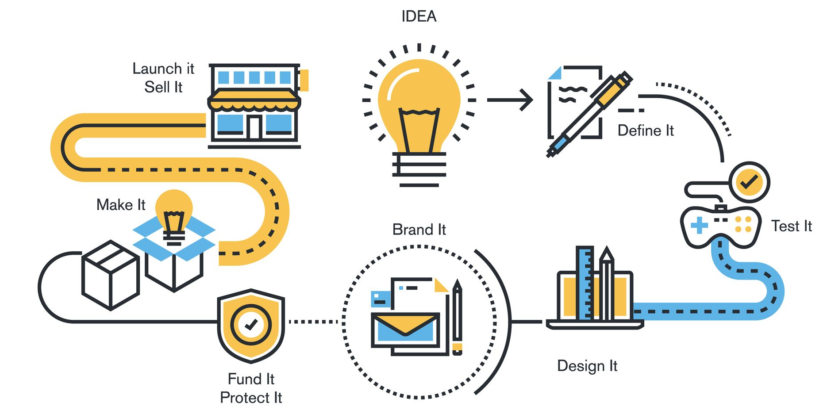
Prototyping Stages

Slide 10
Agile and Lean Principles

Slide 11
Understanding the Core Concepts
Agile and Lean are two methodologies that share similar principles and aim to improve software development processes.
Agile focuses on iterative development, customer satisfaction, and team collaboration.
Lean emphasizes eliminating waste, continuous improvement, and customer value.

Slide 12
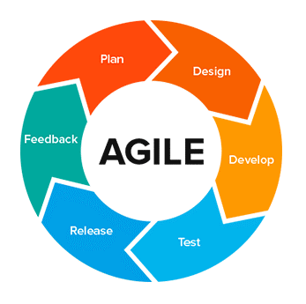
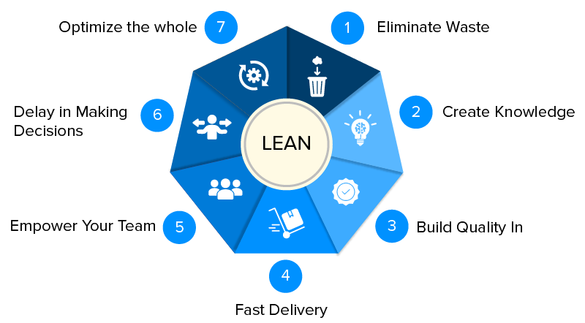

Slide 13
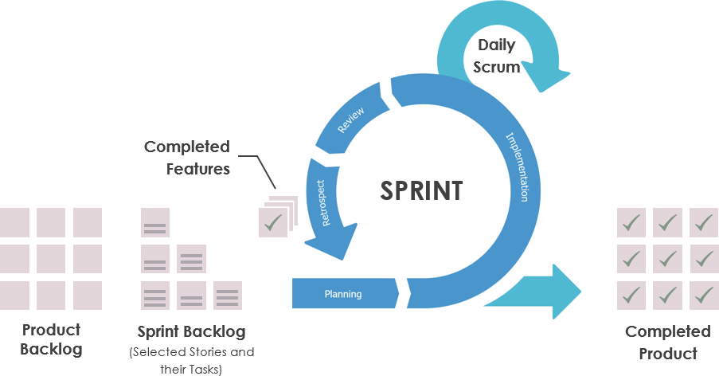
Iterative Development
Breaking down the development process into smaller, manageable chunks, and continuously improving them.
Key benefits
Faster time-to-market, lower risk, and increased adaptability to changing requirements.

Slide 14
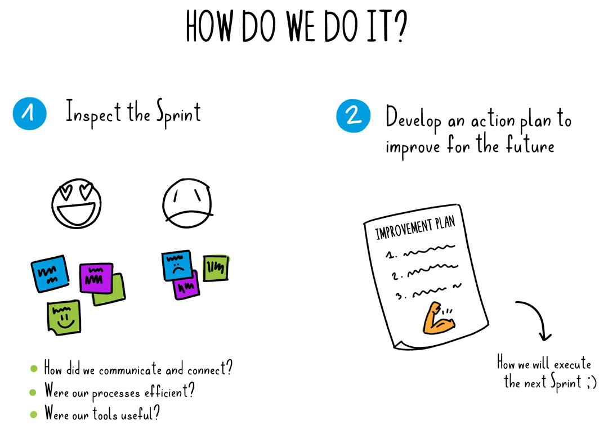
Continuous Improvement
Regularly analyzing and optimizing processes, tools, and techniques to increase efficiency and quality.
Key benefits
Improved productivity, reduced errors, and increased customer satisfaction.

Slide 15
Customer Feedback
Gathering insights and feedback from customers to validate assumptions and improve the product.
Key benefits
Better alignment with customer needs, increased customer satisfaction, and improved product-market fit.
Example: User testing, customer interviews, and feedback sessions.

Slide 16
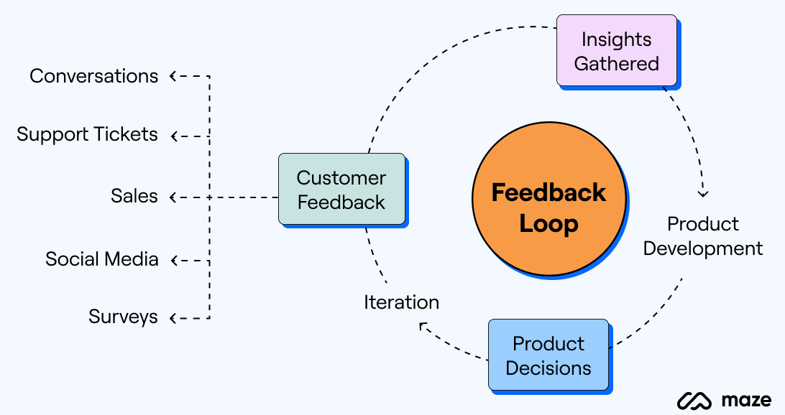
Customer Feedback

Slide 17
Minimizing Waste
Any activity that does not add value to the product or service.
Types of waste
Extra processes, unnecessary features, excessive meetings, and unnecessary overhead.
Key benefits
Reduced costs, increased efficiency, and faster time-to-market.
Example: Identifying and eliminating unnecessary steps in the development process.

Slide 18
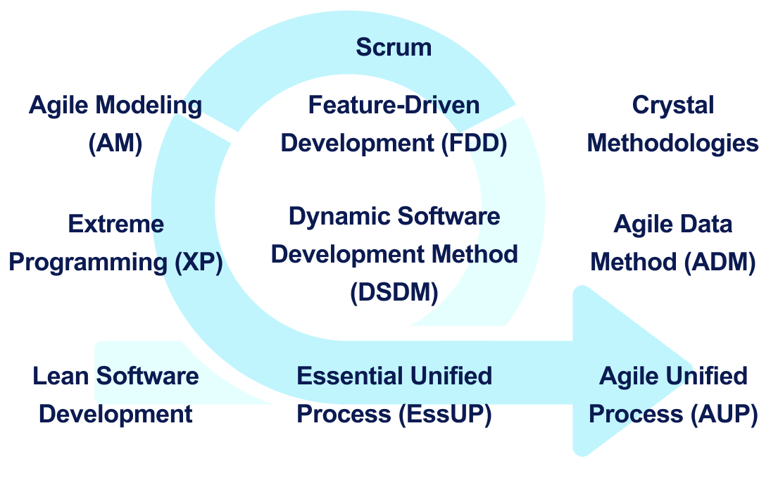
Agile Methodologies

Slide 19
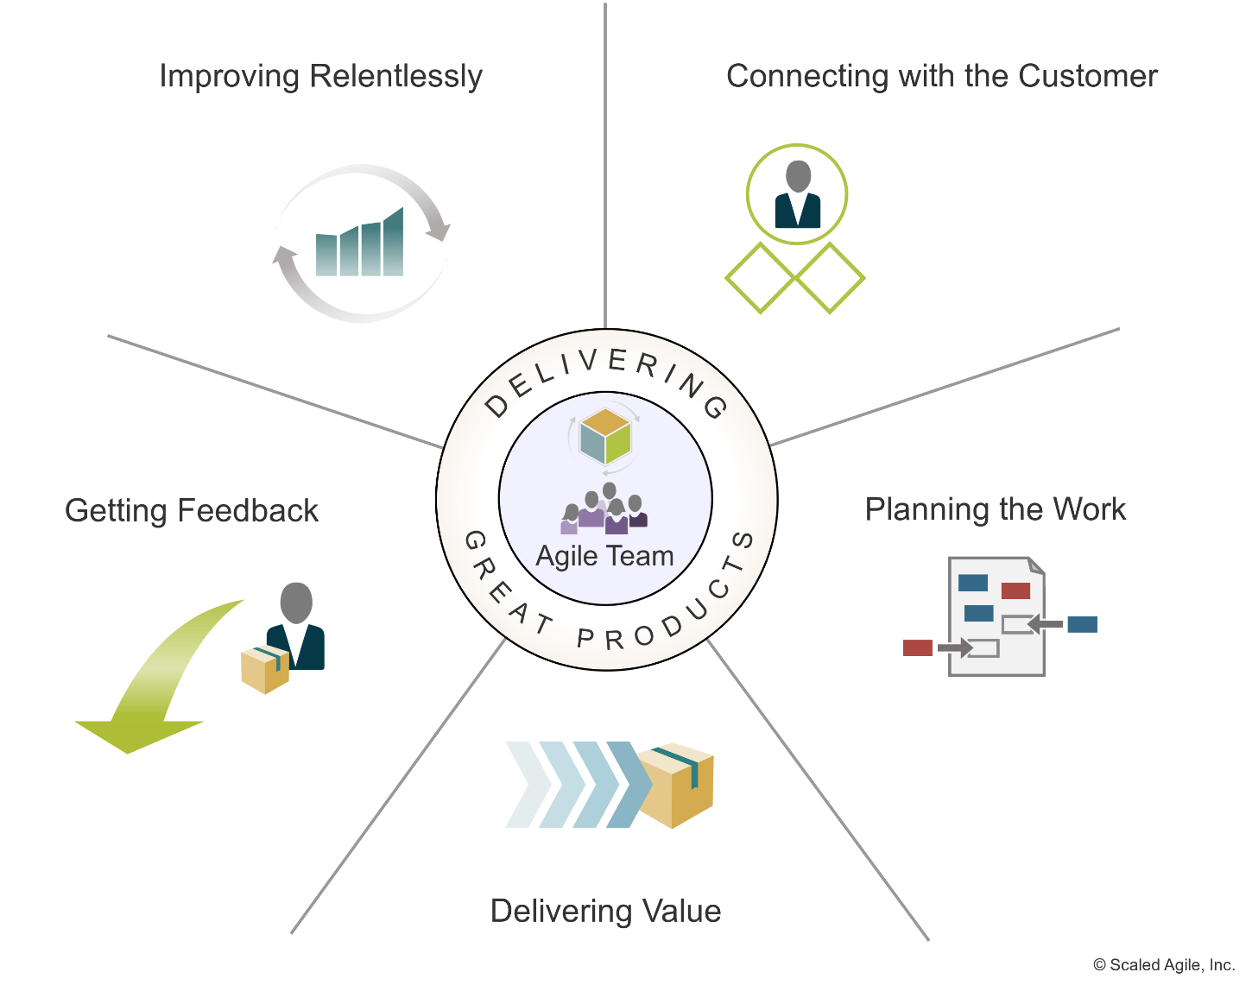
Agile Teams

Slide 20
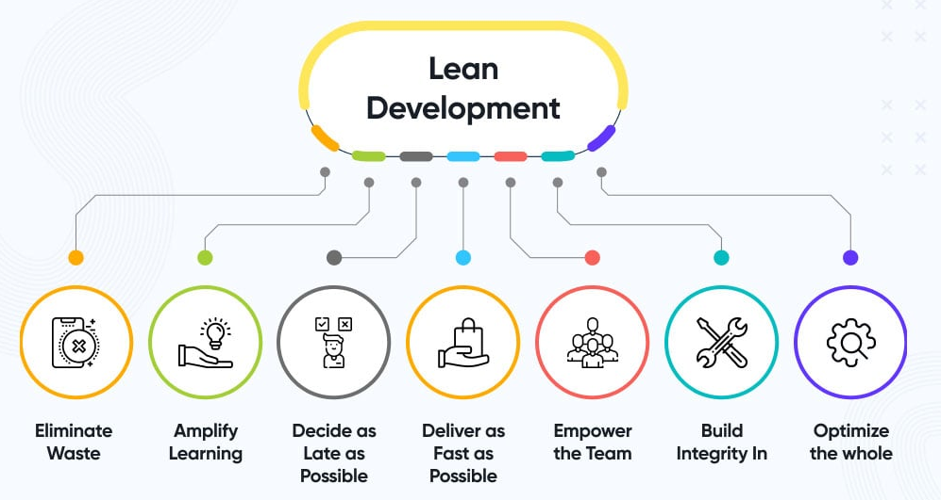
Lean Development

Slide 21
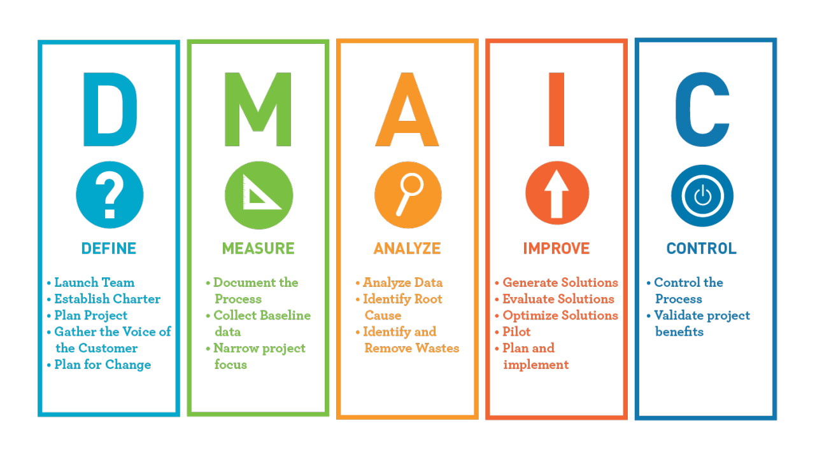
Lean Principles

Slide 22
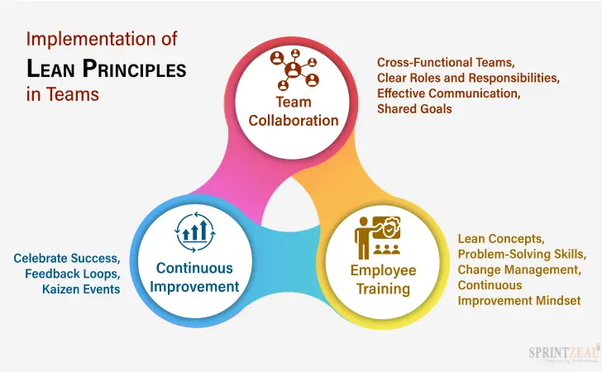
Lean Teams

Slide 23
Implementing Agile and Lean Principles
Key strategies
Start small
train the team
set clear goals, and
continuously improve.
Importance of leadership buy-in and involvement.

Slide 24
Prototyping and Testing

Slide 25
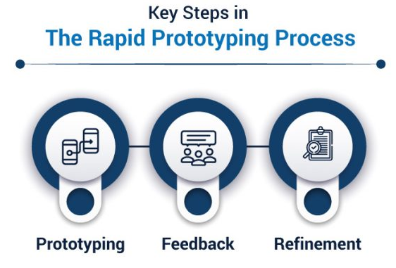
Understanding the Importance of Prototyping
A preliminary version of a product or service that is used to test and validate assumptions.
Allows for early detection of errors, gathers feedback from users, and reduces the risk of investing in a faulty product.

Slide 26
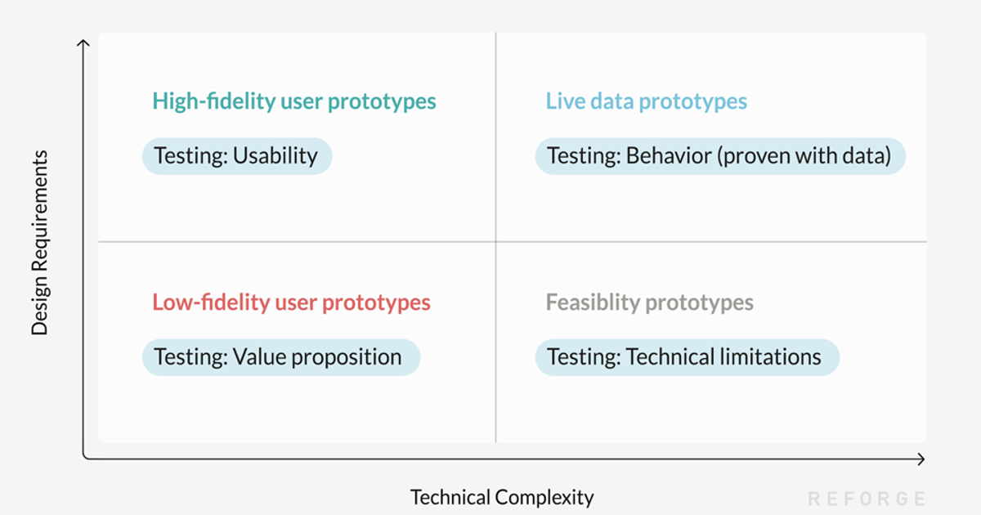
Types of Prototypes

Slide 27
Testing Methods
User Testing
Testing the prototype with real users to gather feedback and identify usability issues.
A/B Testing
Testing two versions of a prototype to compare user behavior and preferences.
Unit Testing
Testing individual components or units of the prototype to ensure they function correctly.

Slide 28
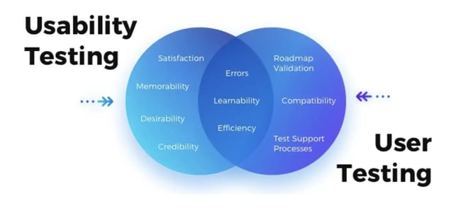
User Testing
Identifies usability issues, validates assumptions, and provides valuable feedback.
Recruiting users, creating test scenarios, and setting up equipment.
Observing users, asking questions, and gathering feedback.

Slide 29
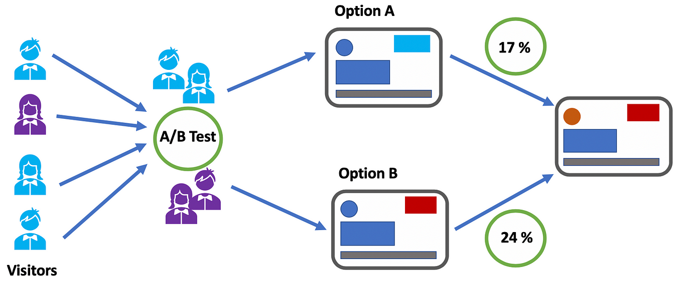
A/B Testing
Testing two versions of a prototype to compare user behavior and preferences.
Identifies which version performs better, validates assumptions, and provides valuable feedback.
Defining the test scope, creating test variants, and setting up tracking and analysis tools.

Slide 30
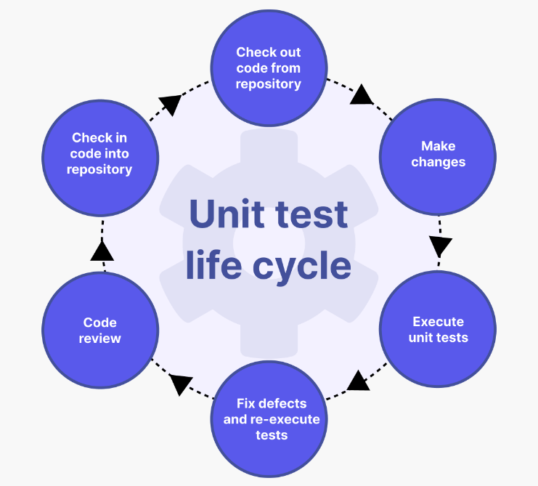
Unit Testing
Testing individual components or units of the prototype to ensure they function correctly.
Identifies bugs and issues early on, reduces the risk of system failures, and improves overall quality.
Defining test cases, creating test data, and setting up testing environments.

Slide 31
Prototyping and Testing in Agile Development
Integrating prototyping and testing into Agile development
Iterative development, continuous improvement, and customer feedback.
Benefits of combining prototyping and testing in Agile development
Faster time-to-market, higher quality, and increased customer satisfaction.

Slide 32
DevOps

Slide 33
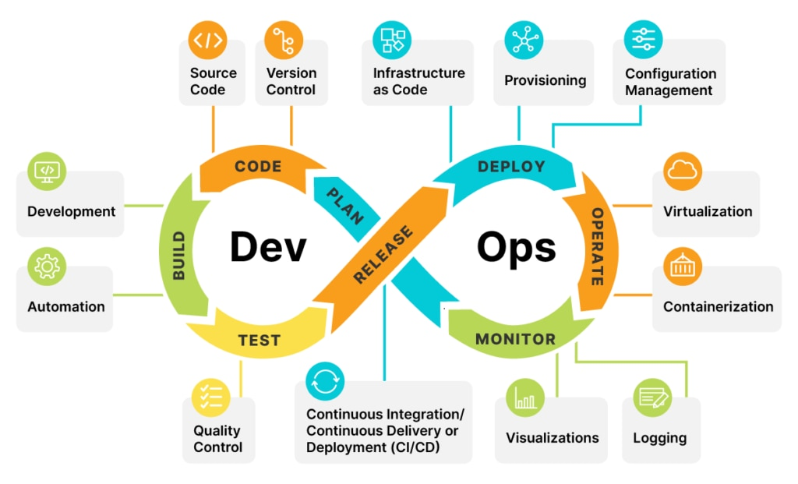
DevOps
A set of practices that emphasizes collaboration and communication between development and operations teams.
Improving efficiency, reducing errors, and increasing customer satisfaction.
In today's fast-paced digital landscape, DevOps is crucial for delivering high-quality software quickly and reliably.

Slide 34
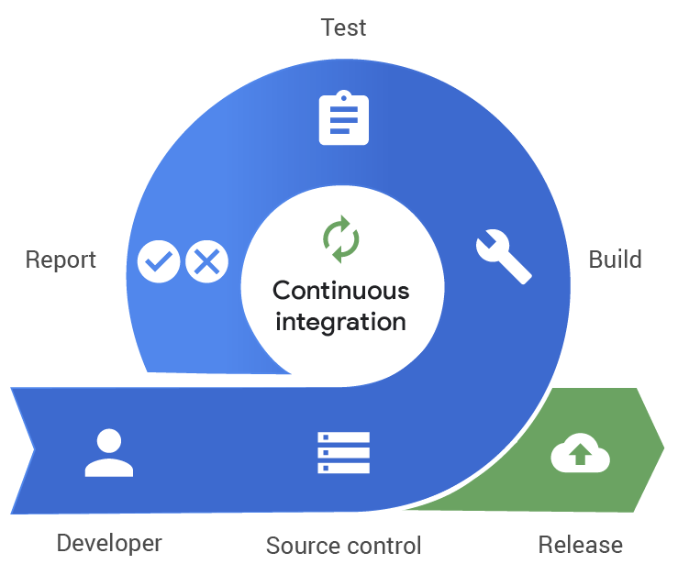
Continuous Integration
The practice of integrating code changes into a central repository frequently, usually through automated processes.
Early detection of integration issues, improved build quality, and reduced risk of project delays.
Tools for continuous integration: Jenkins, Travis CI, CircleCI, and GitLab CI/CD.

Slide 35
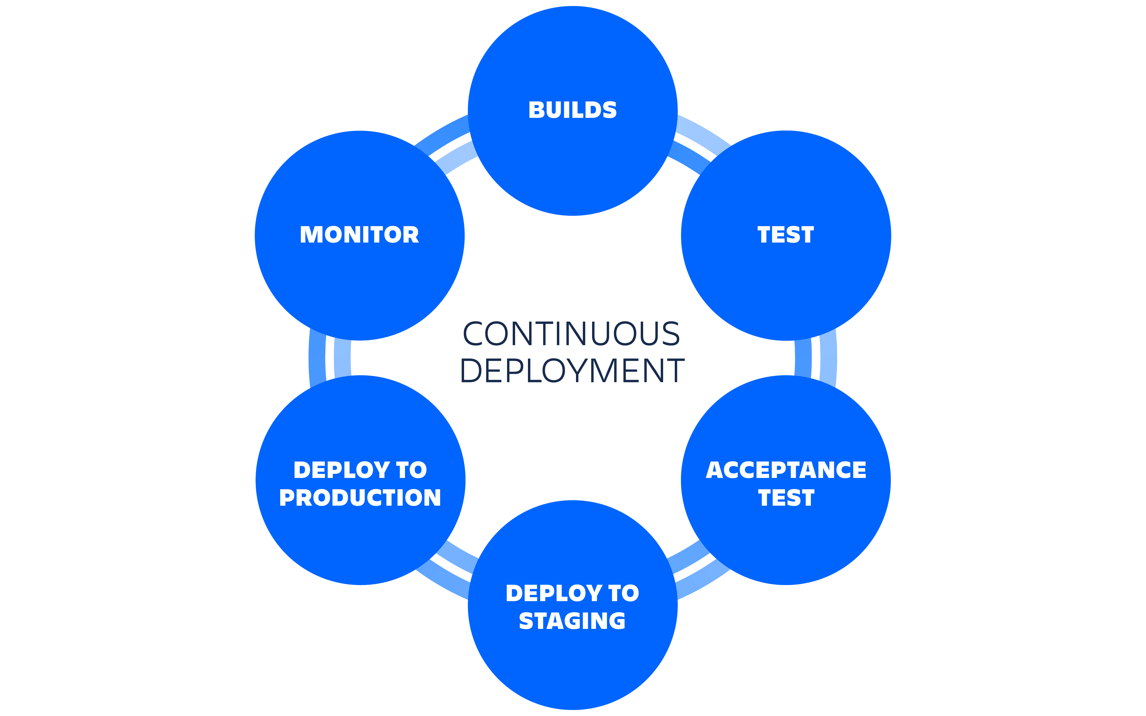
Continuous Deployment
The practice of automatically deploying software changes to production after they pass automated tests.
Faster time-to-market, reduced risk of human error, and improved collaboration between teams.
Tools for continuous deployment: Kubernetes, Docker, Ansible, and Puppet.

Slide 36
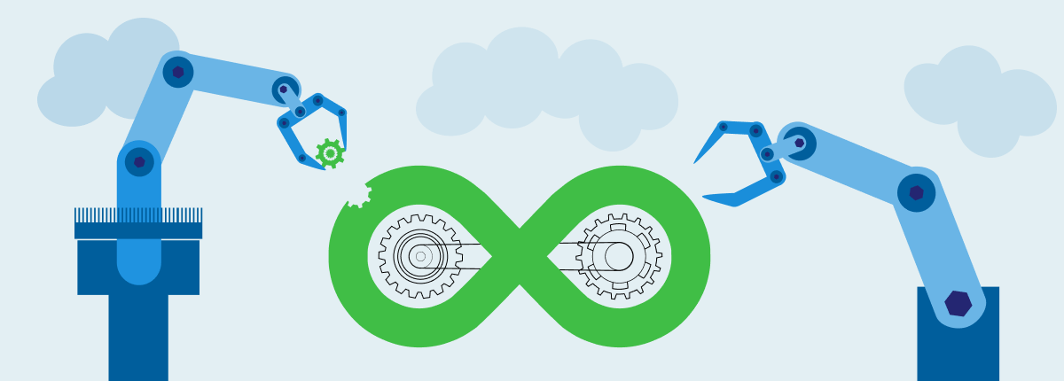
Automation
The use of technology to perform repetitive tasks or processes without human intervention.
Increased efficiency, reduced errors, and improved scalability.
Automation tools: Ansible, SaltStack, Chef, and Puppet.

Slide 37
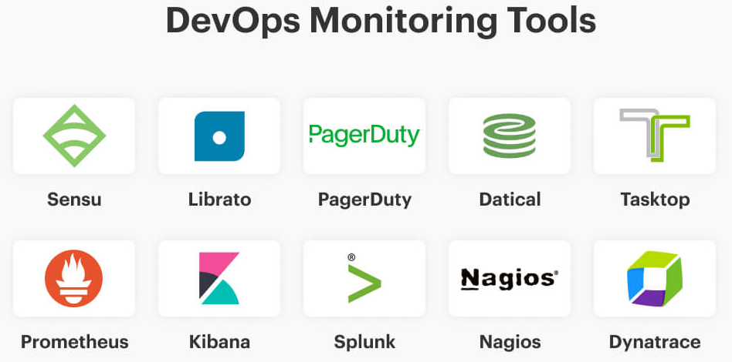
Monitoring
The practice of tracking system performance and health to identify issues and optimize processes.
Improved system reliability, faster issue detection, and better decision-making.
Monitoring tools: Nagios, Prometheus, Grafana, and New Relic.

Slide 38
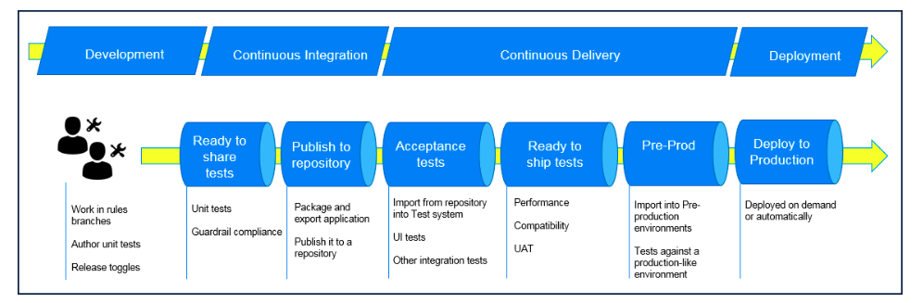
DevOps Pipelines
A visual representation of the DevOps process, highlighting each stage and its dependencies.
Improved collaboration, better communication, and increased transparency.
DevOps pipeline tools: Jenkins, GitLab CI/CD, and CircleCI.

Slide 39
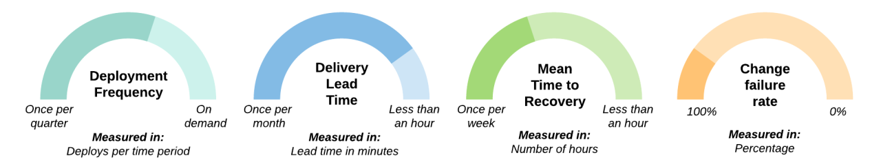
DevOps Metrics
Quantifiable measures used to evaluate the success of DevOps practices and identify areas for improvement.
Key metrics: Lead time, cycle time, deployment frequency, mean time to recover (MTTR), and mean time to detect (MTTD).
Improved process efficiency, faster issue resolution, and better decision-making.

Slide 40
Cloud-based Development and Containerization

Slide 41
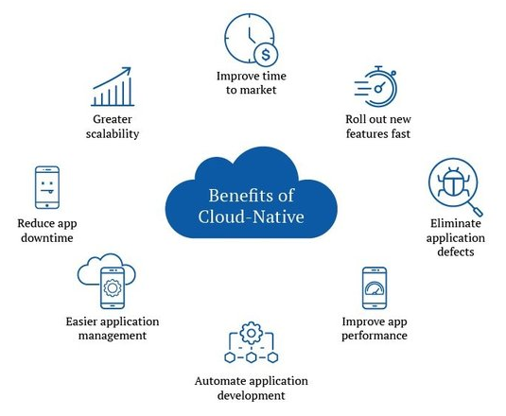
Cloud-based Development and Containerization
The practice of developing, testing, and deploying software applications using cloud computing infrastructure and services.
Containerizationis a technique used to package software applications and their dependencies into self-contained units called containers.
Key benefits
Scalability
Flexibility, and
Cost-effectiveness

Slide 42
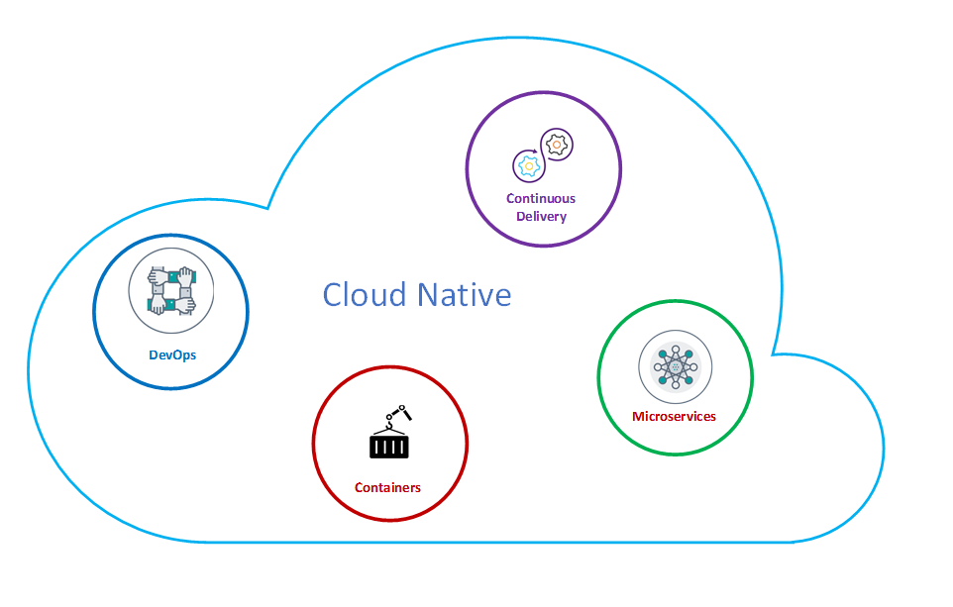
Cloud-based Development and Containerization

Slide 43
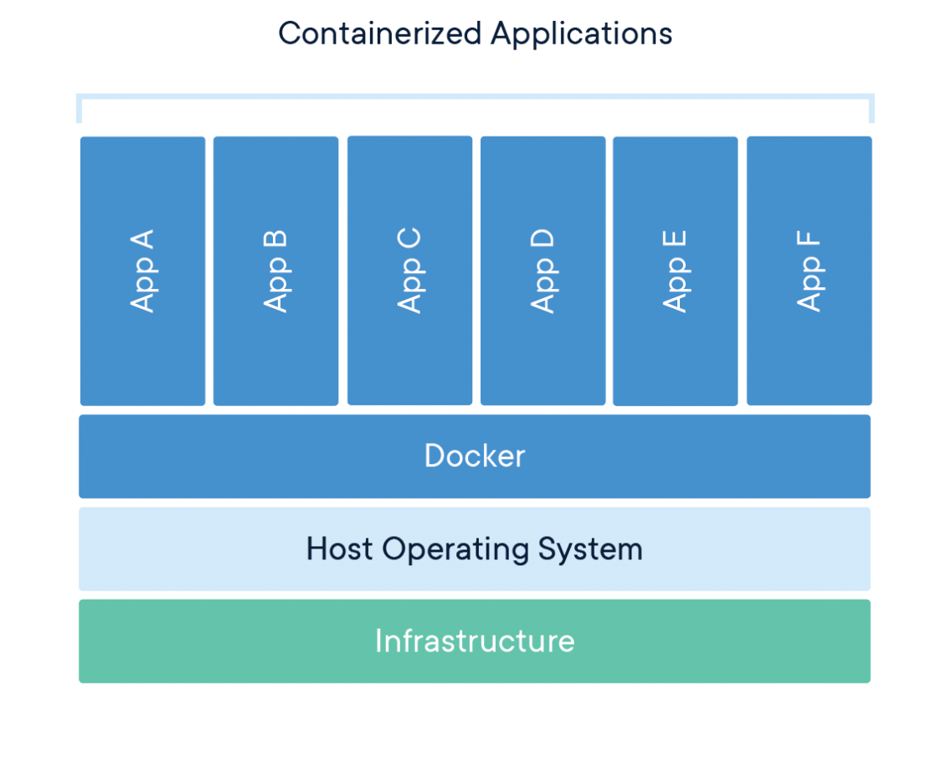

Slide 44
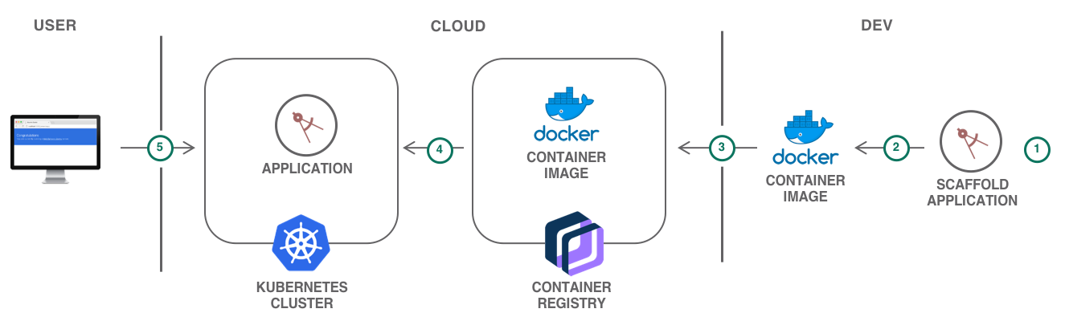

Slide 45
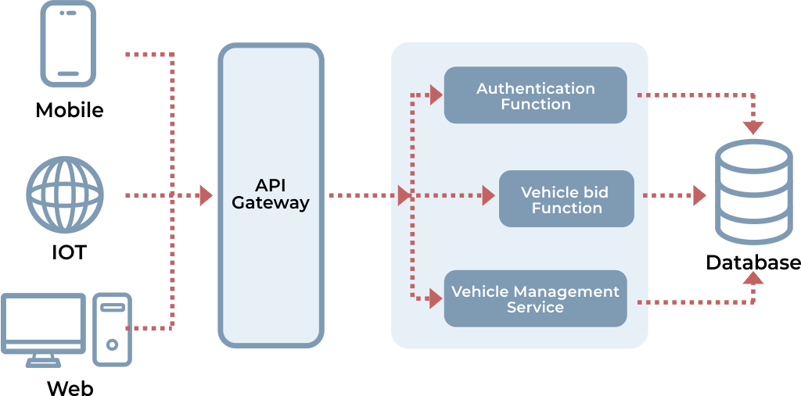
Serverless Computing

Slide 46
Serverless Computing
Serverless computing, also known as function-as-a-service (FaaS), is a cloud computing model where the cloud provider manages the underlying infrastructure and automatically allocates resources to execute code in response to events or requests.
In serverless computing, developers focus solely on writing and deploying individual functions or pieces of code, without the need to provision or manage servers.

Slide 47
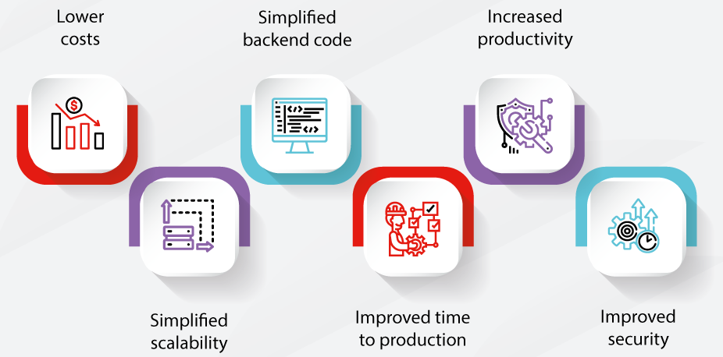
Serverless Computing
Key Benefits:

Slide 48
Key Concepts in Serverless Computing
Event-driven architecture: designing applications around events and triggers
Third-party services: using existing services instead of building everything from scratch
Reduced overhead: reduced infrastructure and maintenance costs

Slide 49
Reusing Existing Libraries and Platforms
Reducing development time: using existing libraries and platforms to speed up development
Leveraging existing resources: using existing resources to reduce costs and improve efficiency
Minimizing waste: reducing unnecessary work and minimizing waste

Slide 50
Reusing Existing Libraries and Platforms
Benefits of Reusing Libraries and Platforms:
Reduced development time and cost
Faster time-to-market
Lower risk of bugs and errors
Greater maintainability and scalability
Access to a wider range of features and functionality

Slide 51
Reusing Existing Libraries and Platforms
Types of Libraries and Platforms:
Open-source libraries (e.g. jQuery, React)
Proprietary libraries (e.g. Google Maps API, Facebook SDK)
Framework libraries (e.g. Spring, Django)
Platforms (e.g. AWS, Google Cloud, Azure)

Slide 52
Reusing Existing Libraries and Platforms
Factors to Consider:
Licensing and legal considerations
Compatibility with other technologies and frameworks
Documentation and community support
Security and privacy concerns
Customization and flexibility requirements

Slide 53
Reusing Existing Libraries and Platforms
Best Practices:
Conducting thorough research and evaluation before selecting a library or platform
Following established coding standards and conventions
Testing and verifying the functionality and performance of the library or platform
Documenting the use of the library or platform in the project's documentation
Keeping up-to-date with updates and security patches

Slide 54
MVP and Customer Feedback

Slide 55
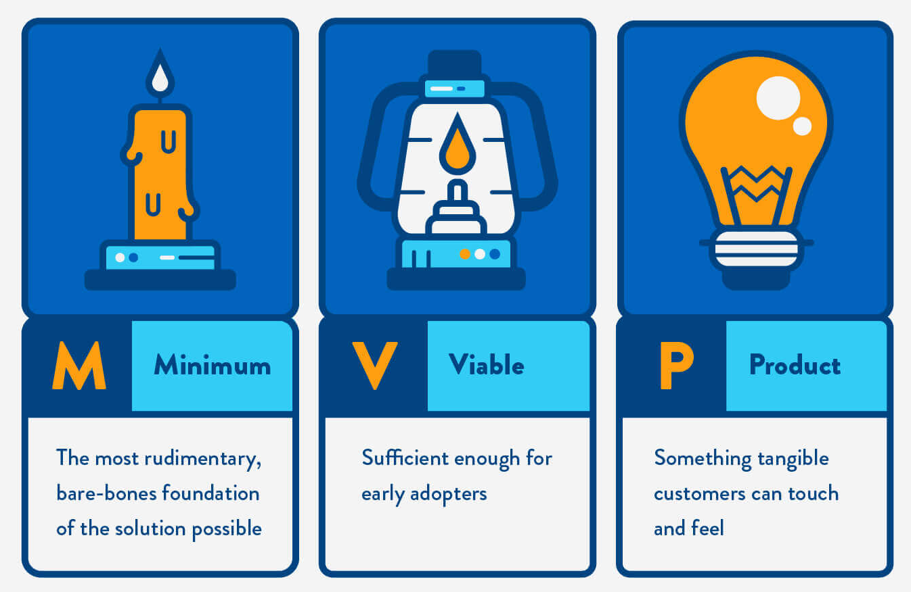
Minimum Viable Product (MVP)
A product or service with just enough features to gather feedback from early customers and validate the product's value proposition.
Reduces risk, saves time and resources, and helps validate product assumptions.

Slide 56
Why MVP is important
Reduces risk
MVP helps to validate the product idea before investing too much time and resources.
Saves time and money
MVP allows you to build only the essential features, reducing development time and cost.
Gathers feedback
MVP helps to gather feedback from early customers, which can be used to improve the product.

Slide 57
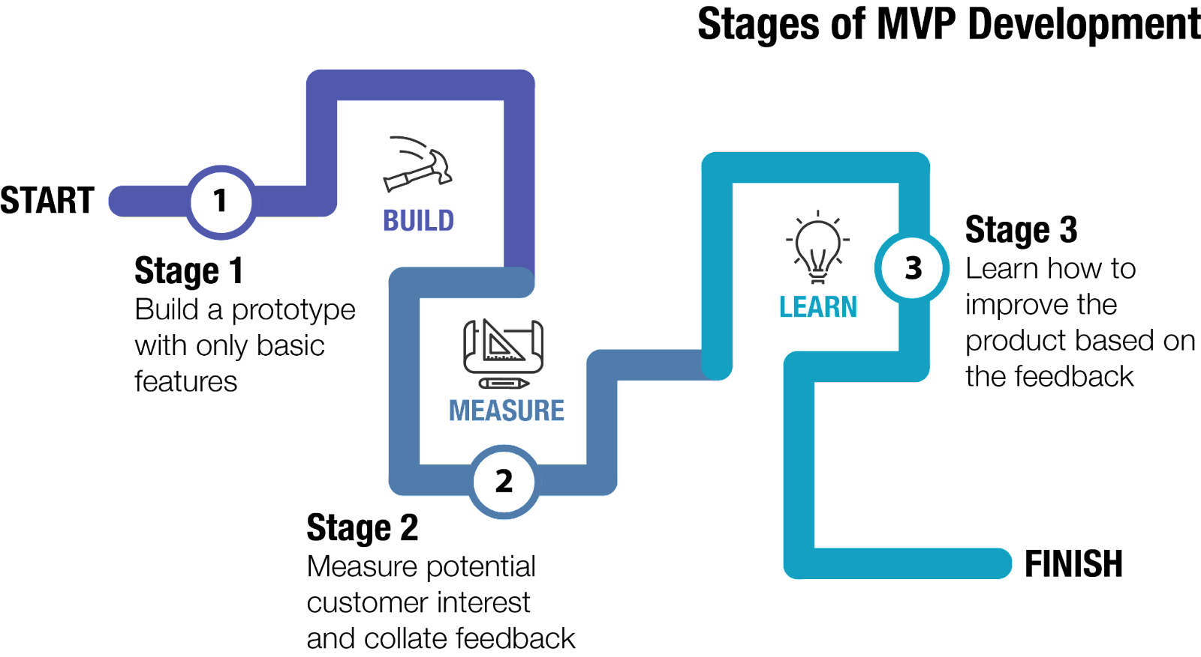
Stages of MVP Development

Slide 58
Benefits of MVP
Reduced risk
Test the product's assumptions without investing a lot of time and resources.
Faster time-to-market
Get your product to market quickly, which can give you a competitive advantage.
Customer feedback
Gather feedback from early customers, which can help you validate the product's value proposition and improve the product.

Slide 59
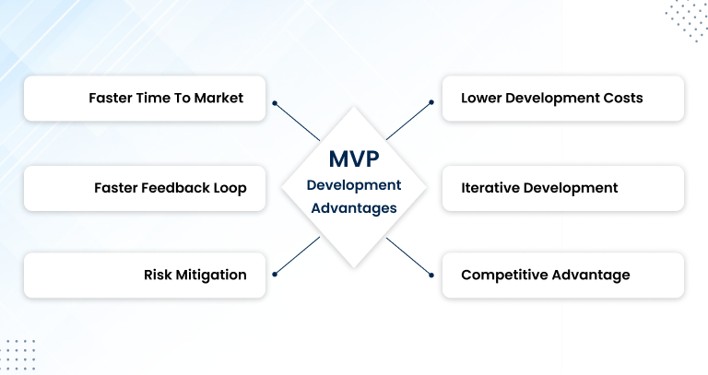
Benefits of MVP

Slide 60
Key Concepts in MVP
Iterative Development
Building and refining a product incrementally, with feedback from customers and stakeholders.
Customer Feedback
Gathering insights from early customers to validate product assumptions and guide product development.
Minimizing Waste
Avoiding unnecessary work and resources by focusing on the most valuable features and iteratively refining the product.

Slide 61
How to create an MVP
Identify the core problem
Determine the main problem you're trying to solve with your product.
Define the target audience
Identify the early customers you want to target with your MVP.
Build the MVP
Develop the essential features that satisfy the target audience.
Test and iterate
Gather feedback from early customers and iterate to improve the product.

Slide 62
Best practices for MVP
Start small
Begin with a small, focused product that solves a specific problem.
Build quickly
Develop the MVP quickly, using available resources and tools.
Test thoroughly
Test the MVP thoroughly to ensure it's functional and usable.
Iterate often
Gather feedback and iterate regularly to improve the product.

Slide 63
Customer Feedback
Helps validate product assumptions and ensures the product meets customer needs.
Helps identify usability issues and areas for improvement.
Helps build trust and rapport with early customers, which can lead to loyalty and positive word-of-mouth.
Methods:
Surveys
Interviews
User testing
Focus groups

Slide 64
Benefits of Gathering Customer Feedback
Improved product development: Customer feedback helps identify areas for improvement and guides product refinement.
Increased customer satisfaction: Gathering feedback shows customers that their opinions matter, leading to higher satisfaction and loyalty.
Competitive advantage: Continuously gathering feedback and iteratively improving the product helps stay ahead of competitors.

Slide 65
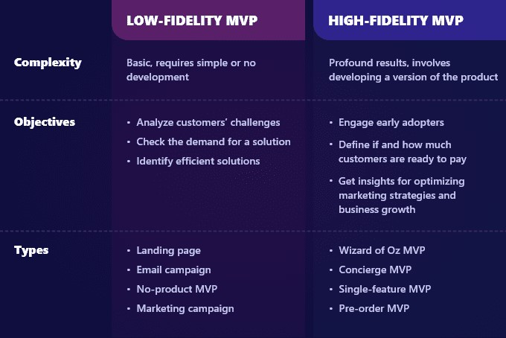
MVP Types

Slide 66
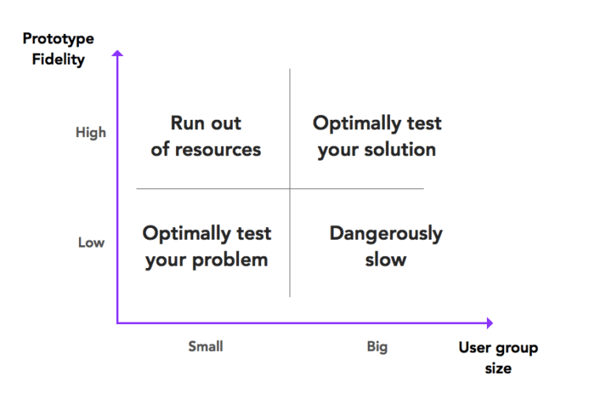
MVP Roadmap

Slide 67
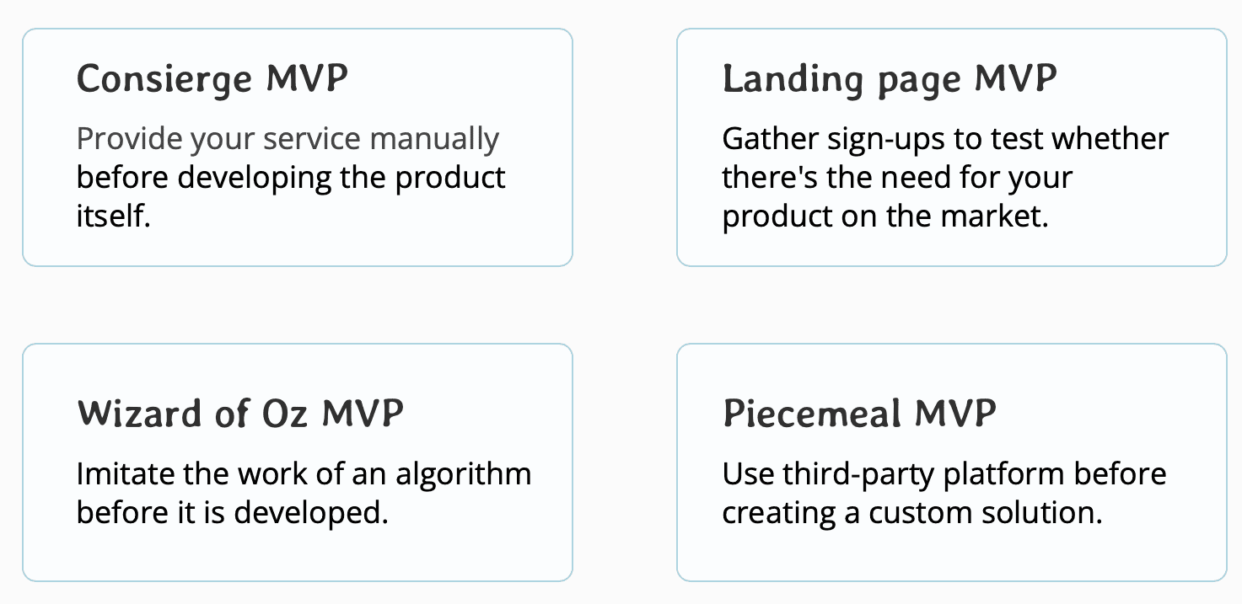
What Are the Types of Minimum Viable Products?
Software prototype
Product design
Demo video
Landing page
Piecemeal
Concierge
Wizard of Oz

Slide 68

Successful MVP Examples
The cost of building a prototype was too high.
To test their value proposition, Dropbox developed a low-fidelity MVP in the form of a video.
Using simple animation, this 3-minute video conveyed the basic functionality of the product and why someone would want to pay to use it.
Because of that video, 75,000 users signed up to use Dropbox before the product was developed.
This gave the founders the confidence they needed to proceed with their development.

Slide 69

Successful MVP Examples
The founders tested their idea by advertising their apartment for rent during a popular conference in their town.
They were able to book their apartment to three separate customers, validating their assumption.
The founders interacted with their guests during their stay, gathering valuable feedback.
They used this experience to generate a list of features to develop for their platform.
This information was used to develop the now famous Airbnb platform.

Slide 70

Successful MVP Examples
Started with a simple messaging platform for teams
Gathered feedback from early users and iterated on the product
Added features such as channels, file sharing, and integrations
Expanded user base to larger organizations
Continued to gather feedback and improve the product
Launched mobile app and introduced customization options
Focused on security and data encryption

